Slide 1
PROJECT 3
SQL Creating the QueensClassSchedule Database
Muhammad Ali Sajjad, Jean Gomez,Chao Wang, Yevgeniy Sumaryev, Andy Qu
7:45 AM GROUP 2

Slide 2
Project 3 Overview
Schema design and UDT.
The next phase involved creating the necessary Schema names and user defined types we want to use in our Database. We aimed to reduce redundancy and improve efficiency
Relationships and Refactoring
At this stage we created the more complex tables in our design in order to establish the necessary relationships with foreign keys. We refactored our code to remove data anomalies
Understanding the Objective
Our first goal was to establish an understanding regarding the task at hand. We wanted to ensure that we have a complete picture of the project.
12/10
12/12
12/14
12/09
12/11
12/13
Database Design
Our next objective focused on figuring out the structure and design of the database. We aimed to distribute the data from Uploadfile.CurrentSemesterCourseOfferings into a normalized DB 3NF design implementation.
Creating Tables and Procedures
We created our tables inside procedures to be able to keep track of the DB workflow. We wanted to keep our database normalized hence we created tables to specialize in storing one aspect of the DB.
Queries and Testing
We then created several queries to actualize and test the ability of our newly implemented database. We compared our queries/usabilty to how that data would have come if we utilized Uploadfile.CurrentSemesterCourseOfferings

Slide 3
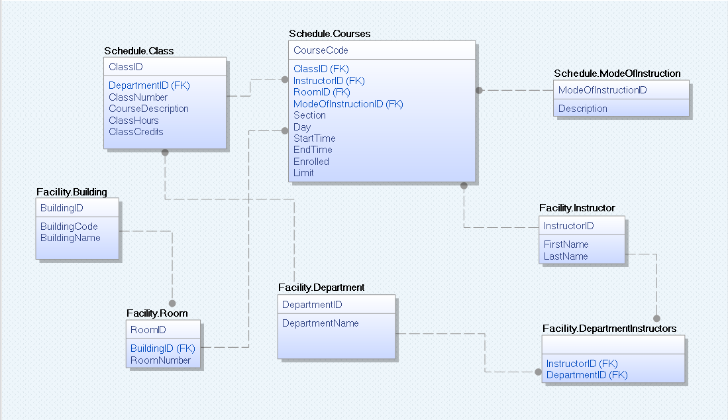
Our DB model prototype

Slide 4
Creating Schemas
CREATE SCHEMA ClassScheduleProcedure
CREATE SCHEMA DBSecurity
CREATE SCHEMA Process
CREATE SCHEMA Facility
CREATE SCHEMA Schedule
CREATE SCHEMA UDT

Slide 5
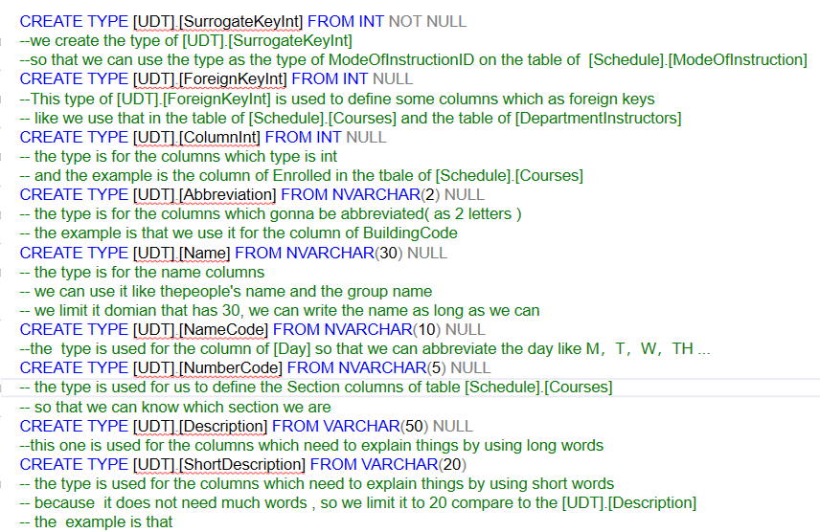
Create Types

Slide 6
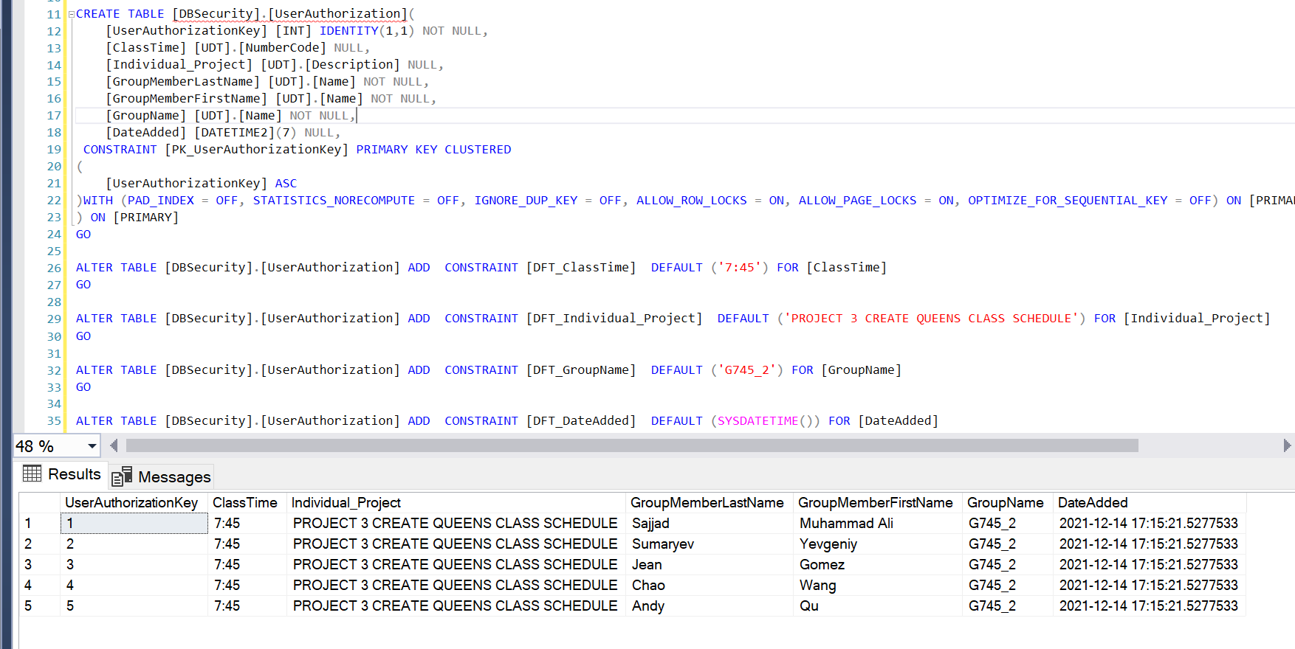
DBSecurity.UserAuthorization

Slide 7
Process.usp_TrackWorkFlow
Tracks the WorkFlow step of every procedure
Inserts the data into WorkFlowSteps Table
Gets called from every procedure
Uses DateTime variables to keep track of time

Slide 8
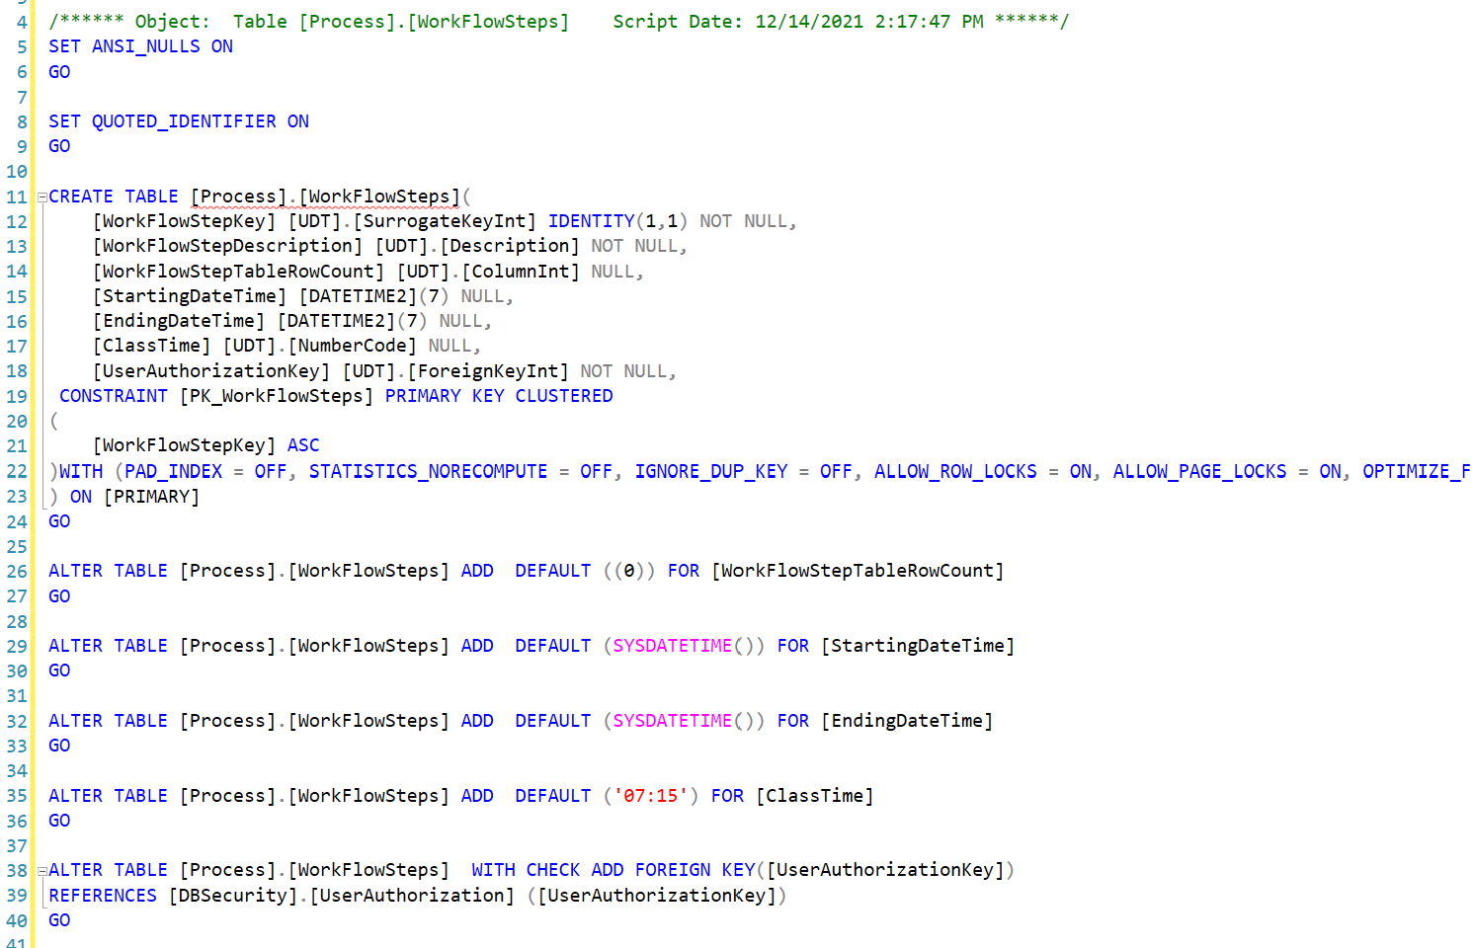
Process.WorkFlowSteps

Slide 9
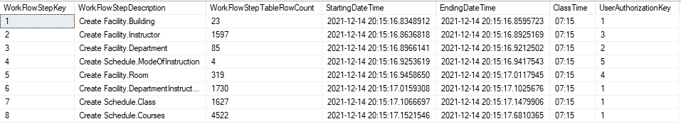
Process.TrackFlowSteps

Slide 10
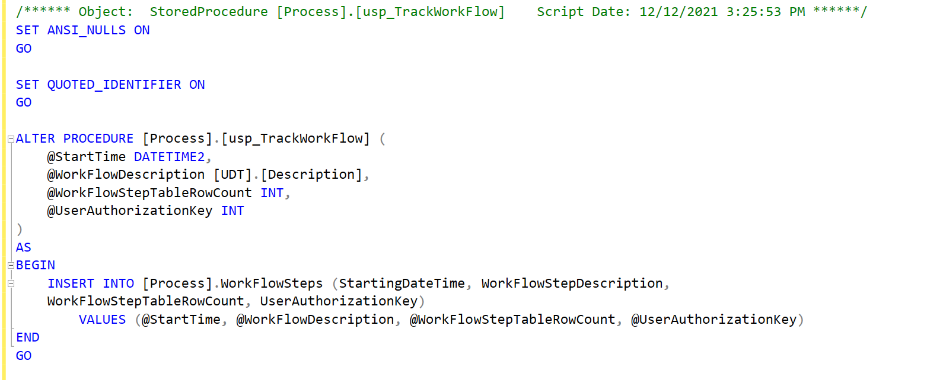
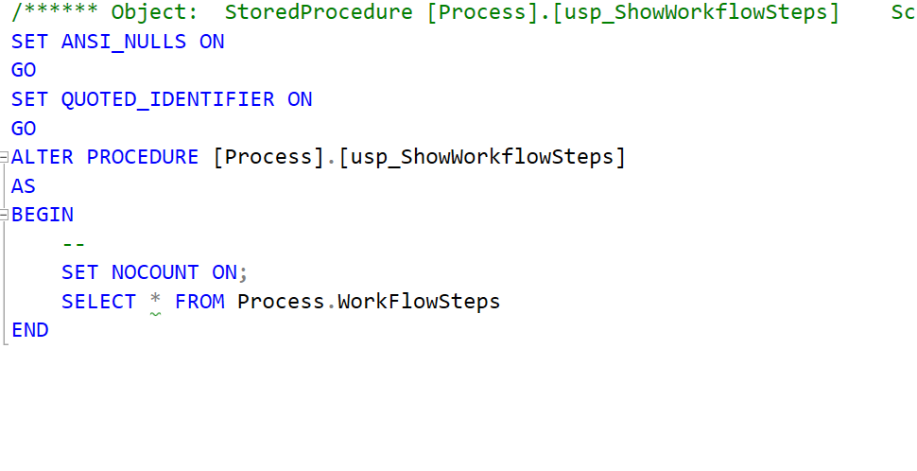
Process.usp_TrackWorkFlow and usp_ShowWorkFlowSteps

Slide 11
Facility.Department
Procedure for creating Department table was used to automate the table creation process
Department table was created by selecting course description from CurrentSemesterTable and selecting only the letters and ignoring the remaining digits
Description that didn’t conform to the format was ignored, for example entries that didn’t contain department name were not used
Auto incremented identity key column was also added to the table in order to maintain the relationships to other tables if needed
WorkFlowSteps Table was modified with necessary data

Slide 12
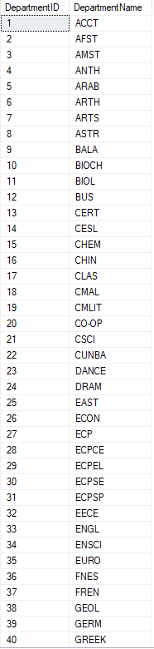
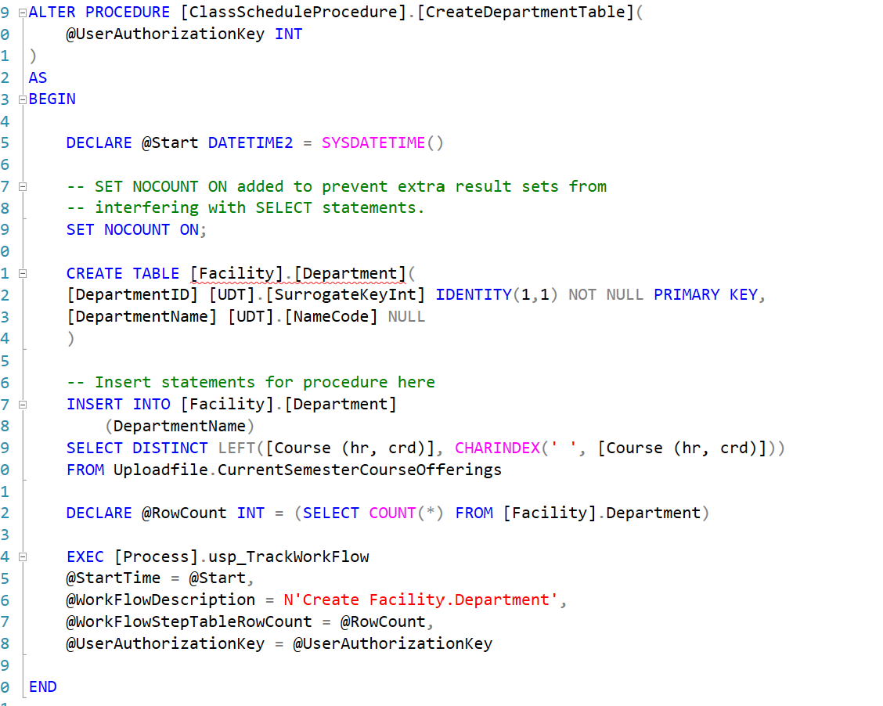
Creating Department Table

Slide 13
FACILITY.INSTRUCTOR
For the instructor table I wanted to create a unique identity key for each instructor
Used an identity for instructorID and set it as the primary key
The instructor name was setup as Lastname, Firstname so when we insert the parameters we specify Lastname will be the first part we retrieve then firstname
We use distinct clause to not repeat instructors and keep IDs unique
Using left() function, we pass the string and then use CHARINDEX() to find us the index where we have the comma and subtract 1 from it so it only takes in the string and not the comma for LastName.
To find the FirstName from our string of instructor we use the right() function and then length of string minus the index where the comma is found to retrieve the FirstName

Slide 14
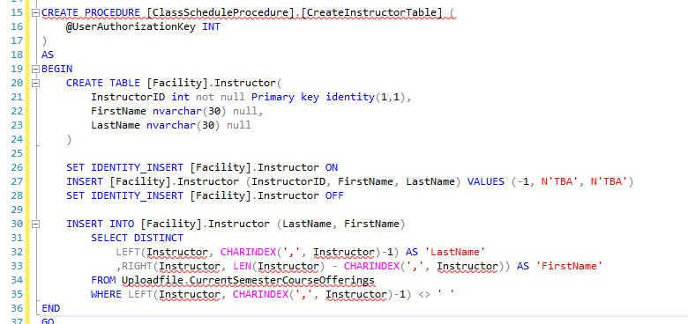
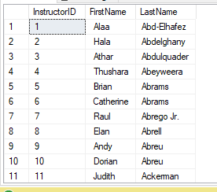
FACILITY.INSTRUCTOR

Slide 15
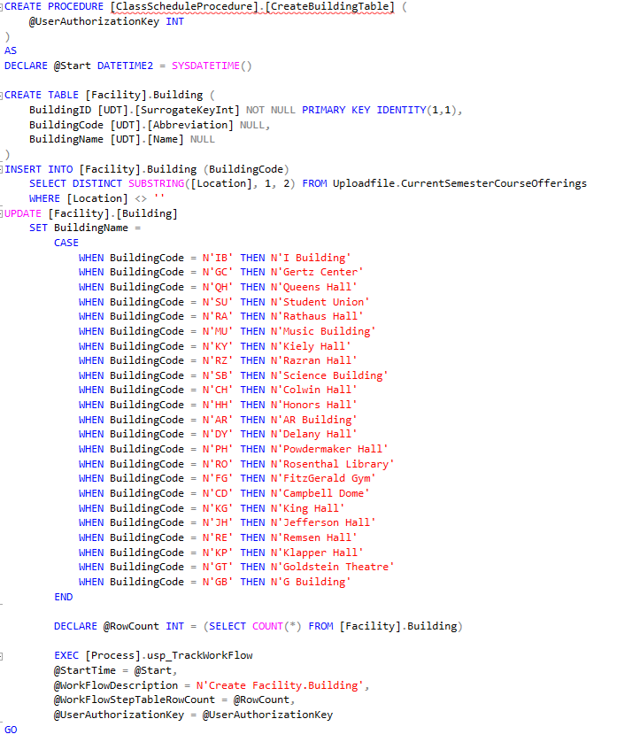
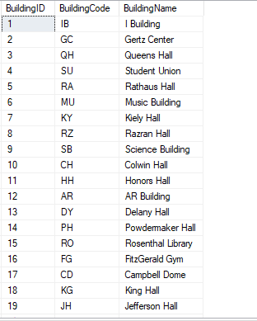
Facility.Building

Slide 16
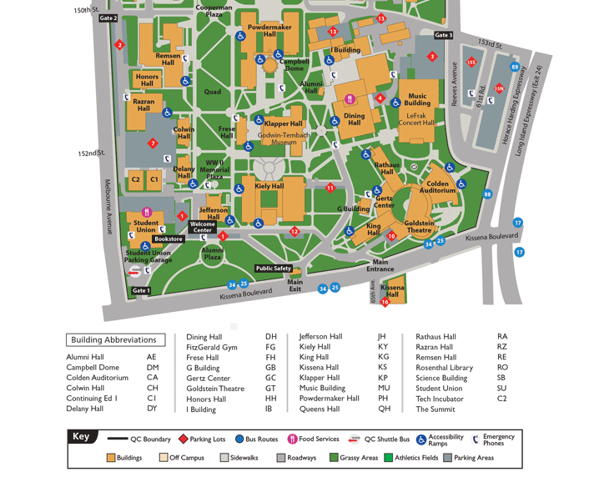
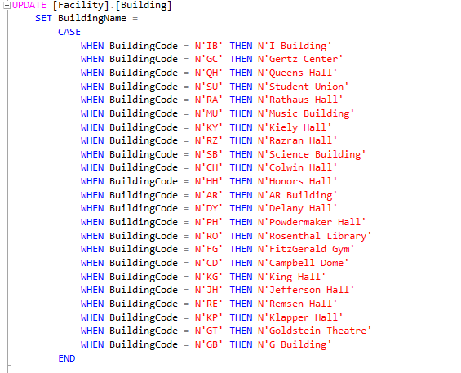
Facility.Building Additional we found ourselves

Slide 17
Facility.Room
This Procedure is designed to create the [Facility].Room table. And this table contains the RoomID, the BuildingID, and theRoomNumber.
We use roomID as the primary key of this table for identity, then, buildingID is not only used as a column in this table, but it is also used as a foreign key to the [Facility]. [Building] table, roomNumber is the specific room number that each roomID corresponds to.
We insert a special value that Its roomID is -1 , and roomNumber is TBA, It represents all the classes which do not have the classrooms like the online classes
Then, we insert the values from the Uploadfile.CurrentSemesterCourseOfferings table to fill our table

Slide 18
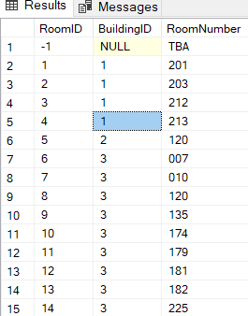
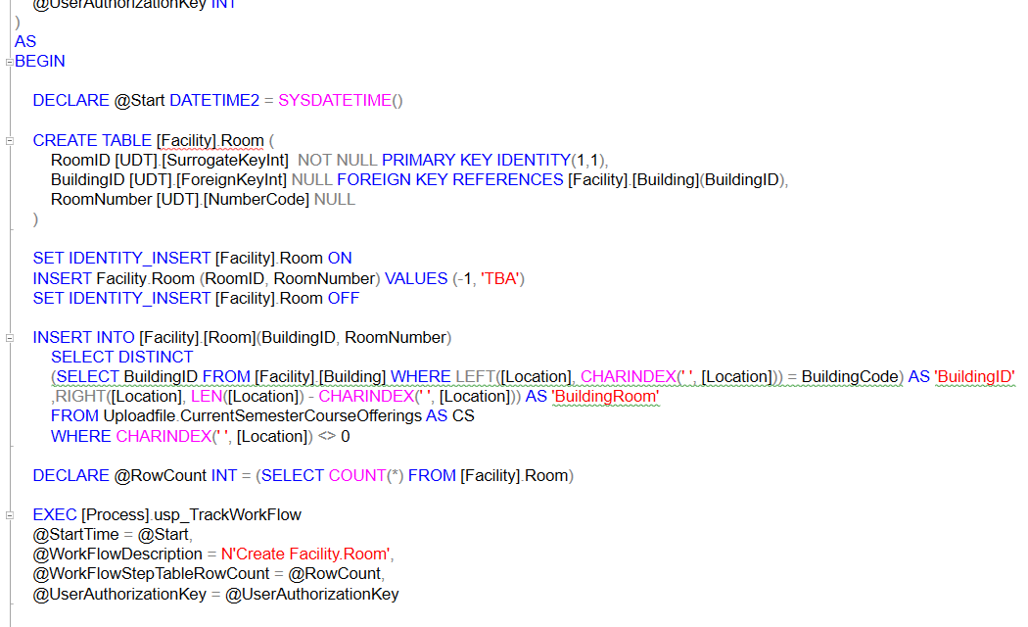
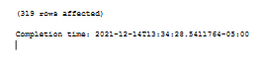
Create the table of Facility.Room

Slide 19
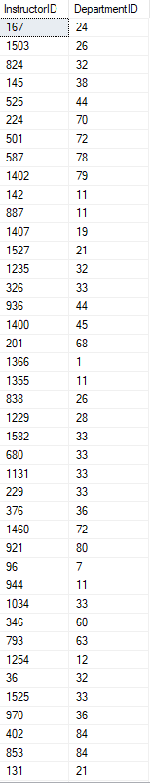
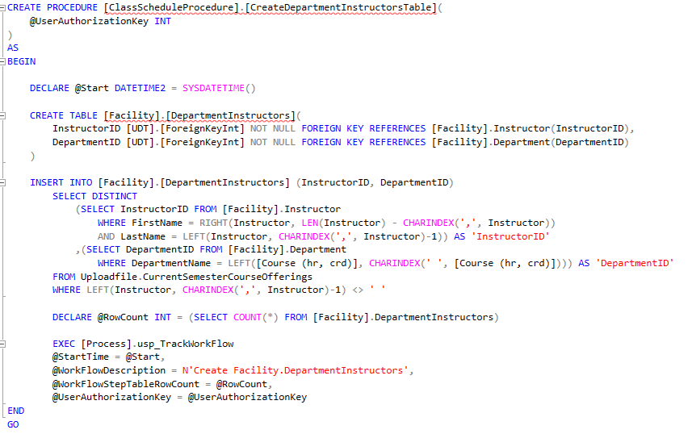
Facility.DepartmentInstructors

Slide 20
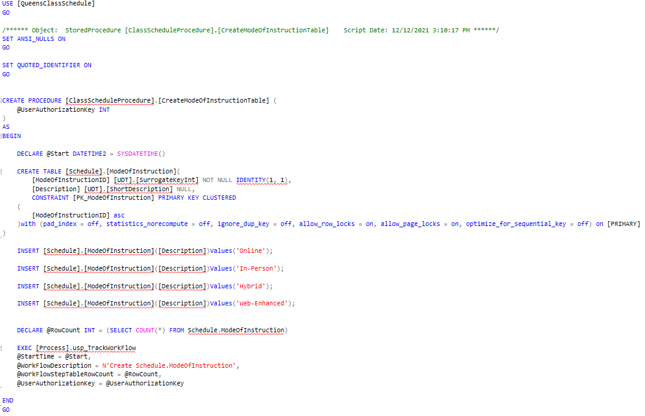
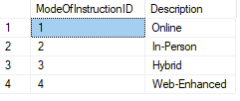
[Schedule].[ModeOfInstruction]

Slide 21
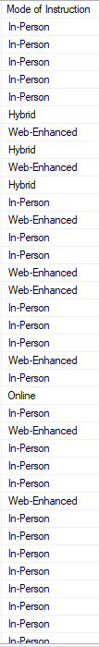

Slide 22
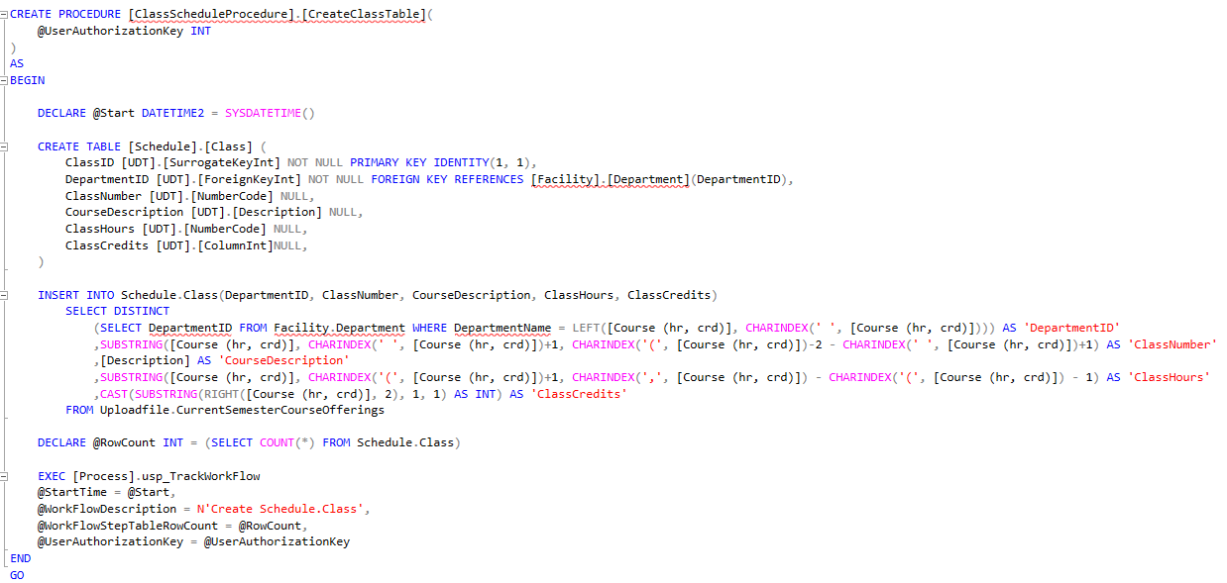
Schedule.Class

Slide 23
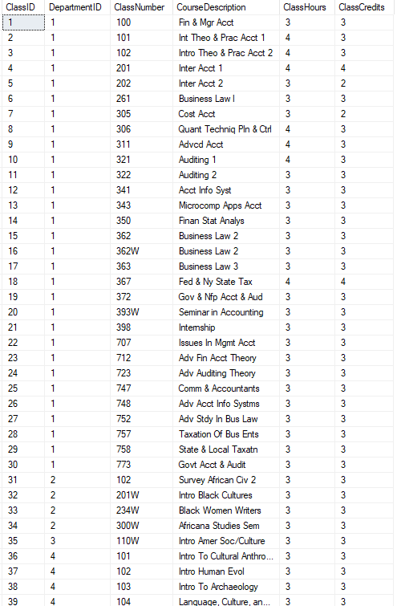
Schedule.Class
Specializing is Class data only
No unnecessary data
Normalized Design implementation
much lighter to join and access
identity based ClassID
Easy Department lookup via foreign key relationship using DepartmentID
Split class data into multiple columns from original data

Slide 24
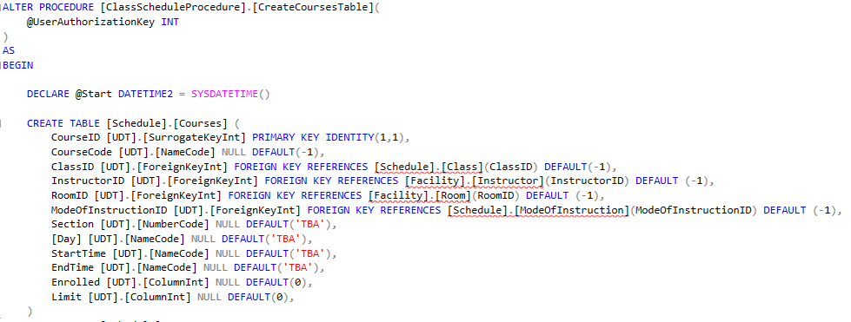
Schedule.Courses

Slide 25
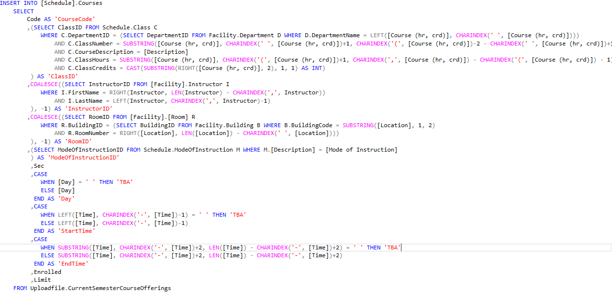
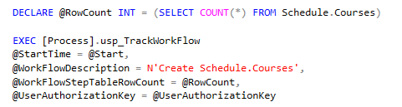
Schedule.Courses data

Slide 26
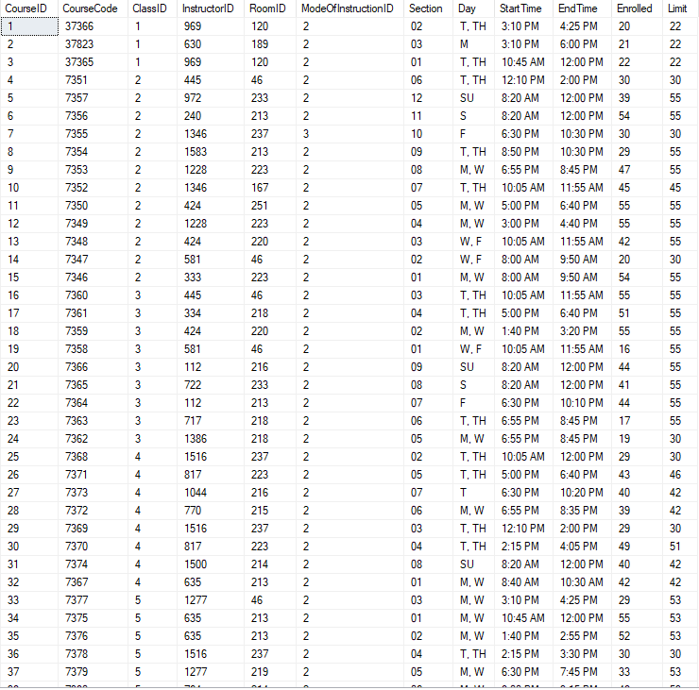
Schedule.Courses
Normalized implementation
Lighter data
easily accessible
columns tell you one type of information, no clustered messy data
foreign key relationships for easy lookup and entry

Slide 27
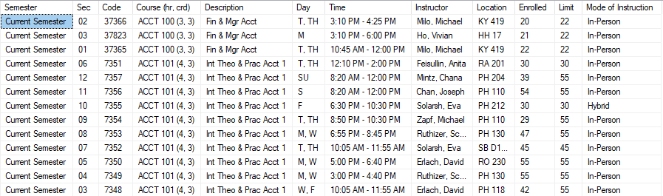
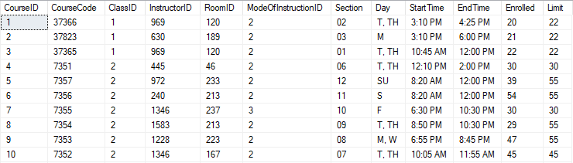
Comparison of a few rows

Slide 28
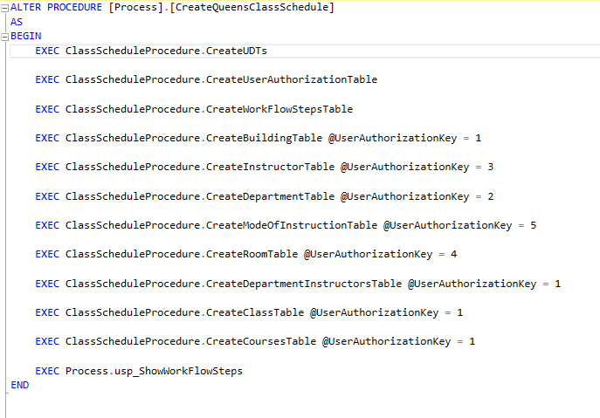
Process.CreateQueensClassSchedule

Slide 29
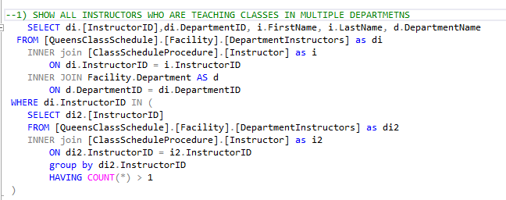
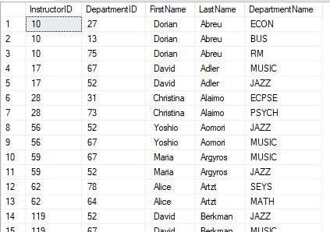
Question:1

Slide 30
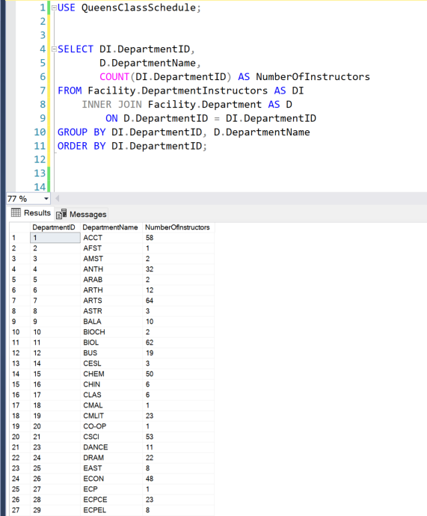
Question:2
How many instructors are in each department?

Slide 31
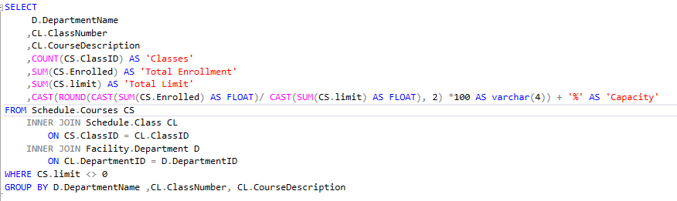
Question:3

Slide 32
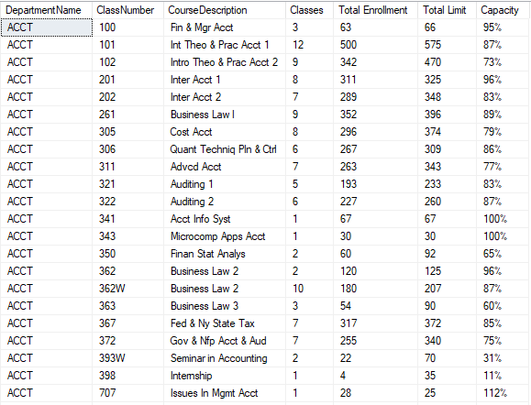
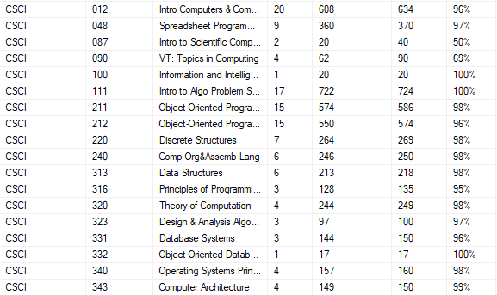
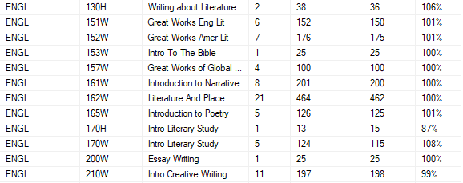
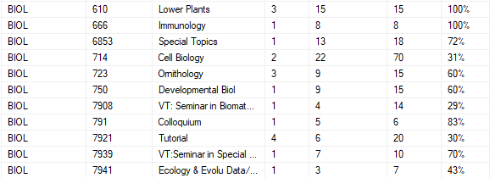

Slide 33
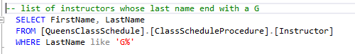
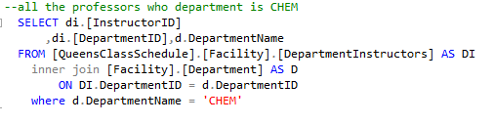
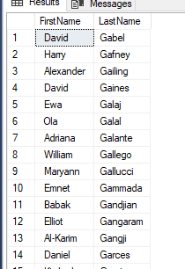
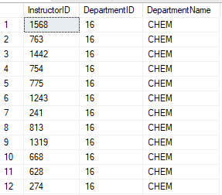
Queries
Jean

Slide 34
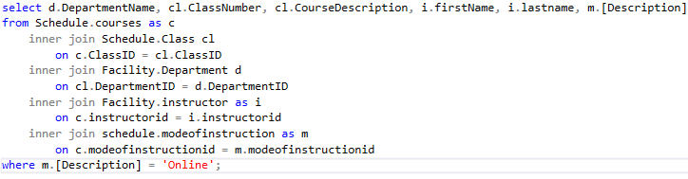
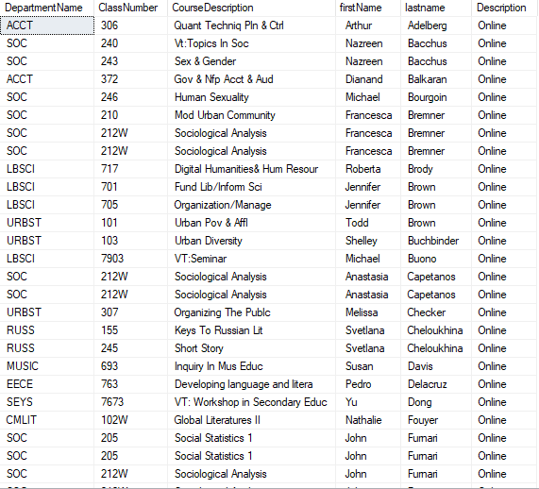
Queries

Slide 35
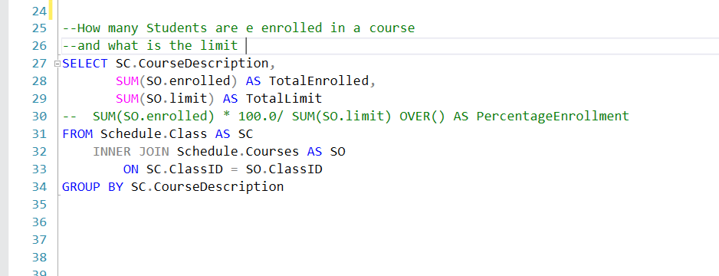
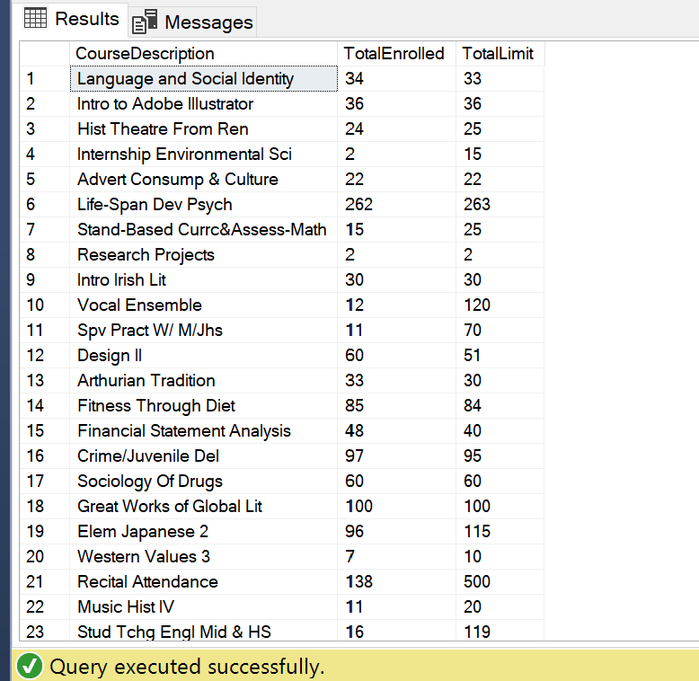
Queries

Slide 36
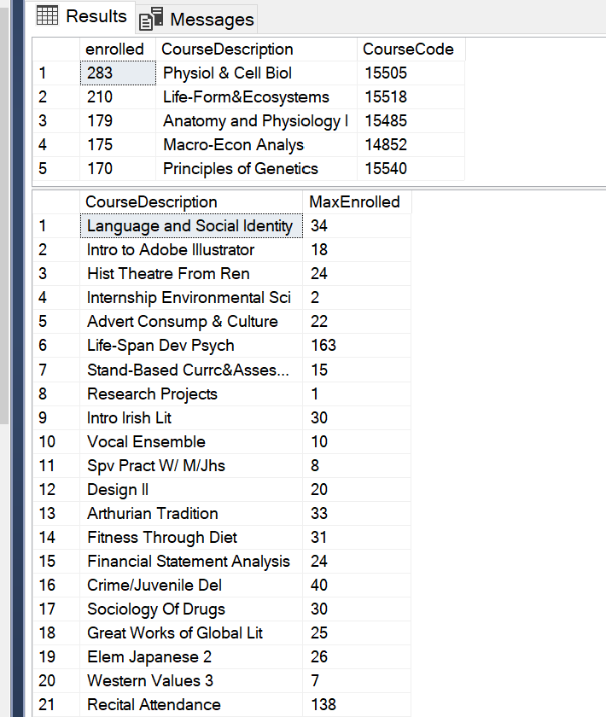
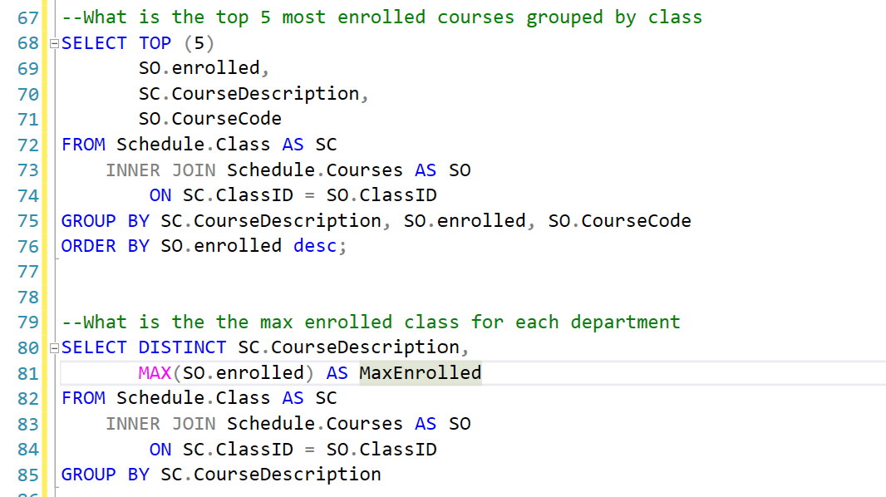
Queries

Slide 37




Queries

Slide 38




Queries

Slide 39
Redgate SQL prompt, SQL doc, SQL Compare
Using Redgate tools such as SQL prompt, SQL doc and SQL Compare were very helpful in our productivity as it helped us write code faster, more efficiently and it helped us see the connections between data when creating tables
Autocompletion tool allowed for quicker typing and querying, Tab History helped to quickly locate past queries and SQL search was used to find necessary data fast
Dependency diagram assisted in quickly finding connection between tables in order to run queries
SQL Compare helped quickly see the difference between tables and DB during different snapshots during development

Slide 40




Slide 41




